Slide 1
WILLIAM JAMES
“MYSTICISM” AND “CONCLUSIONS”
FROM
THE VARIETIES OF RELIGIOUS EXPERIENCE

Slide 2
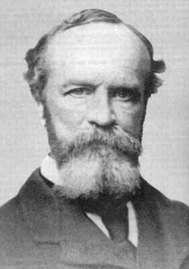
WILLIAM JAMES (1842 - 1910 )

Slide 3
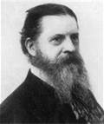
CHARLES SAUNDERS PEIRCE (1839 - 1914 )

Slide 4
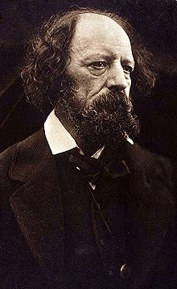
ALFRED LORD TENNYSON (1809 - 1892)

Slide 5
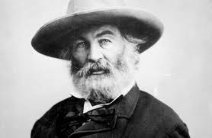
WALT WHITMAN (1819 - 1892)

Slide 6
MYSTIC STATES (ACCORDING TO WILLIAM JAMES, p. 327)
Mystic states have and ought to have absolute authority for those who have them.
(2) No authority emanates from them for others.
(3) They show that “rational consciousness” is only one kind. They open the “possibility of certain orders of truth.”

Slide 7
BELIEFS TYPICALLY INVOLVED IN “THE RELIGIOUS LIFE”, p. 60
The visible world is part of a more spiritual universe from which it draws its chief significance.
(2) Union (or harmonious relationship) with that higher universe is our true end.
(3) Prayer (or inner communion) really does work and spiritual energy flows in and produces effects.

Slide 8
RELIGIOUS LIFE BELIEFS (CONT.)
The religious life adds a new zest to life.
(5) The believer takes himself to be safe and the religious life produces a temper of peace and loving affection toward others.

Slide 9
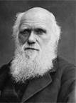
CHARLES DARWIN (1809 - 1882)

Slide 10
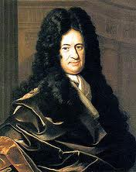
GOTTFRIED WILHELM VON LEIBNIZ (1646 -1716 )

Slide 11
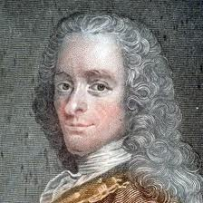
VOLTAIRE (1694-1778)

Slide 12
THE PRAGMATIC DEFINITION (OR THEORY OF) TRUTH
“An idea (or a belief) is true if
and only if it is useful (has
utility, is verifiable.)”

